Slide 1

PART 1 : DC ANALYSIS
Chapter 2 Basic Laws
2022.1

Slide 2
Chapter2 Basic Laws
2.1 Ohm’s Law and Linear Resistor.
2.2 Nodes, Branches, and Loops.
2.3 Kirchhoff’s Laws.
2.4 Equivalent Subcircuits.
2.5 Series Resistors and Voltage Division.
2.6 Parallel Resistors and Current Division.
2.7 Wye-Delta Transformations.

Slide 3
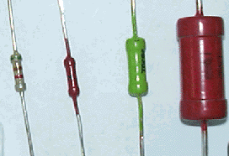
2.1 Ohm’s Law and Linear Resistor
The circuit element used to model the current-resisting behavior of a material is the resistor.
A element which dissipates energy but stores none is said to consist solely of resistance.
u～i relations
u
Volt-ampere
relationship
i

Slide 4

2.1 Ohm’s Law and Linear Resistor
Linear resistor
u～i relations
Ohm’s Law
u
Volt-ampere :
A line through origin
i
u、i : Associate reference direction
R
i
+
－
u
R--Resistance ：Ω (Ohm)
in S.I. units
G –conductance: S (Siemens)

Slide 5
2.1 Ohm’s Law and Linear Resistor
Notice:
(1) u-i relationship for a linearity resistance
Ohm’s Law
(2) Imply linearity resistance is nonmemory
(3) Active sign convention
R
i
u = –R i
-
+
u
Passive sign convention
R
i
+
－
u

Slide 6
2.1 Ohm’s Law and Linear Resistor
Power of Resistance
R
i
p = u i= i²R =u² / R
-
+
u
R
p = –u i= –(–R i) i= i² R
= –u(–u/ R) = u²/ R
i
-
+
u
Resistor dissipate energy

Slide 7



2.1 Ohm’s Law and Linear Resistor
Example:
Calculate the power of each circuit element.
_
Solution
+
+
+
5V
10V
_
_
i
Figure 2.1
satisfy ：P（deliver）＝P（absorb）

Slide 8
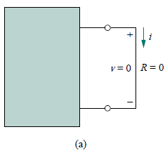

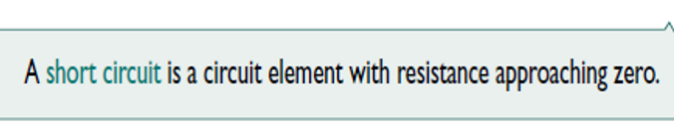
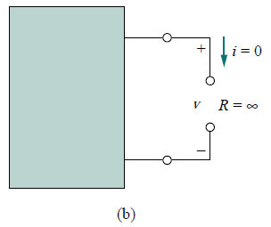


Two extreme possible values of R
An element with R = 0 is called a short circuit.
An element with R =∞ is known as an open circuit.

Slide 9
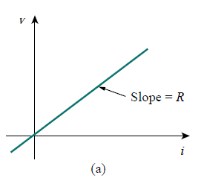
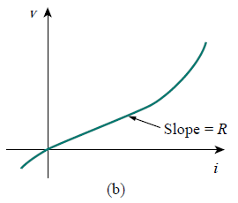
Notice：Only linear resistor obeys Ohm’s law. It has a constant resistance.
A nonlinear resistor does not obey Ohm’s law. Its resistance varies with current.
Figure 2.2

Slide 10
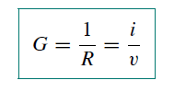
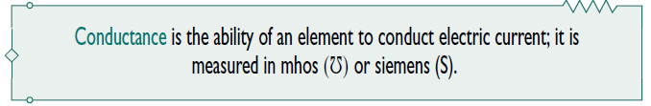
conductance
A useful quantity in circuit analysis is the reciprocal of resistance R, known as conductance and denoted by G:
The conductance is a measure of how well an element will conduct electric current.

Slide 11


Power
The power dissipated by a resistor can be expressed in terms of R.
The power dissipated by a resistor may also be expressed in terms of G.
1. The power dissipated in a resistor is a nonlinear function of either current or voltage.
2. Since R and G are positive quantities, the power dissipated in a resistor is always positive. Thus, a resistor always absorbs power from the circuit. This confirms the idea that a resistor is a passive element, incapable of generating energy.

Slide 12
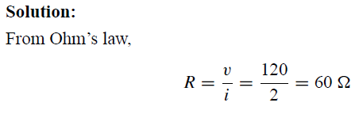
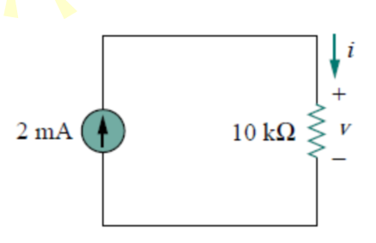
Example
An electric iron draws 2 A at 120 V. Find its resistance.
Practice
For the circuit shown in Fig. 2.3, calculate the voltage v, the conductance G, and the power p absorbed by the resistor.

Slide 13
Example
An electric iron draws 2 A at 120 V. Find its resistance.
Practice
For the circuit shown in Fig. 2.3, calculate the voltage v, the conductance G, and the power p absorbed by the resistor.
Fig. 2.3

Slide 14
Summary
1. A resistor is a passive element in which the voltage u across it is directly proportional to the current i through it. That is, a resistor is a device that obeys Ohm’s law。
R
i
-
+
u
R
i
u = –R i
-
+
u

Slide 15

2.
open circuit.
short circuit.
3. The conductance G

Slide 16

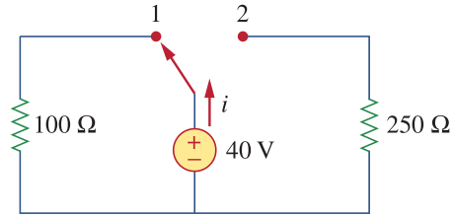
填空题
2分
1. Calculate current i when the switch is in position 1.
i= [填空1]A.
2. Find the current when the switch is in position 2.
i= [填空2]A.
正常使用填空题需3.0以上版本雨课堂
作答

Slide 17
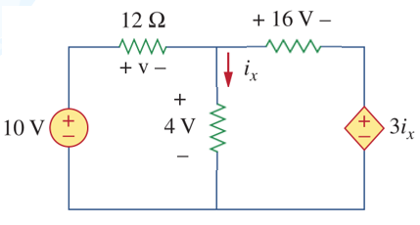
Homework （2th time）
1. Calculate the absorbed power of each resistor and the supplied power of each source in the circuit.

